Slide 1
CAPSTONE PROJECT - 3
Cardiovascular Risk Prediction
Created By : Sakshi Dhyani

Slide 2
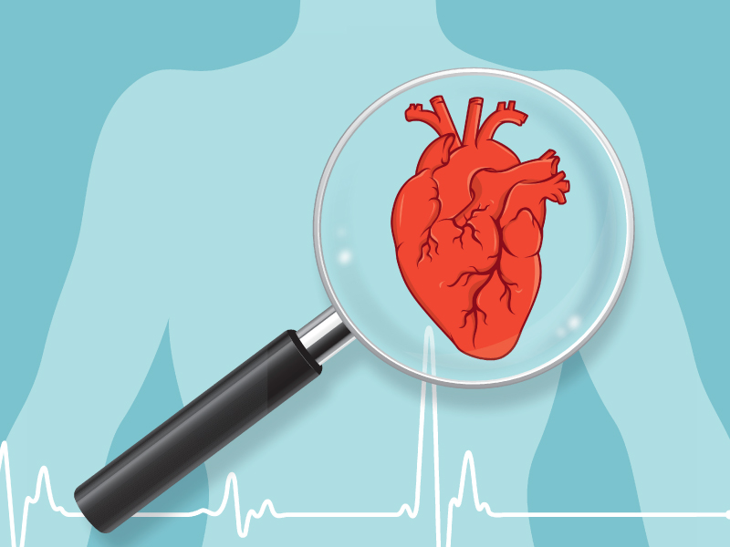
Project Details
In this project, the dataset is from an ongoing cardiovascular study on residents of the town of Framingham, Massachusetts. The target is to predict whether the patient has a 10-year risk of future coronary heart disease (CHD).
Steps performed
Data cleaning
Data visualizations
Data preprocessing
Model Implementation
Evaluation metrics

Slide 3
Data Summary
Independent Features
Dependent Feature
Sex : Male or Female
Age : Age of the patient
Is_smoking : whether patient smokes or not
Cigs Per Day : average no of cigarettes that person smoked on one day
BP Meds: Whether patient is on blood pressure medication or not
Prevalent Stroke: Whether patient previously had a stroke
Prevalent Hyp: Whether patient was hypertensive or not
Diabetes: Whether or not patient has diabetes
Tot Chol : Total Cholesterol level
Sys BP : Systolic Blood pressure
Dia BP : Diastolic Blood pressure
BMI : Body Mass Index
Heart Rate
Glucose : Glucose level
10- year risk of coronary heart disease (CHD)

Slide 4
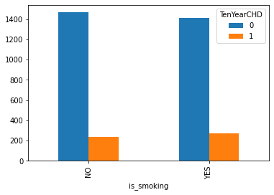
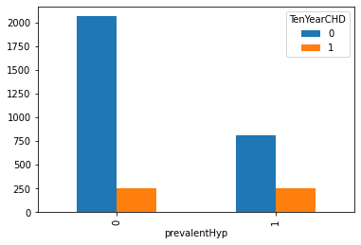
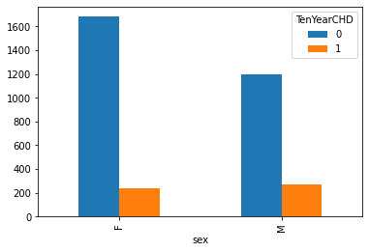
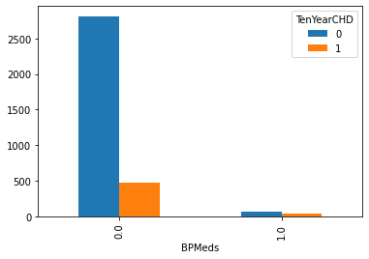
Exploratory Data Analysis
Bar Plots

Slide 5
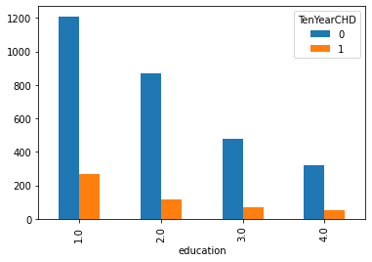
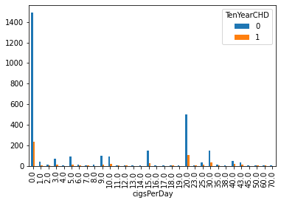
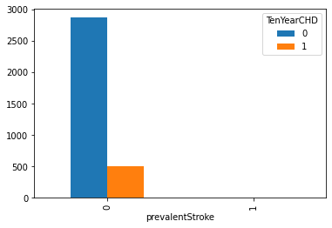
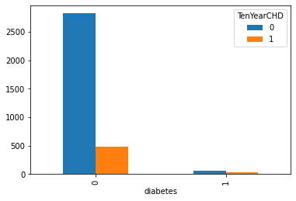
Exploratory Data Analysis
Bar Plots

Slide 6
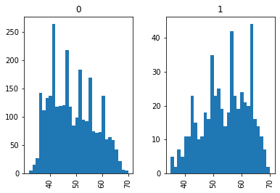
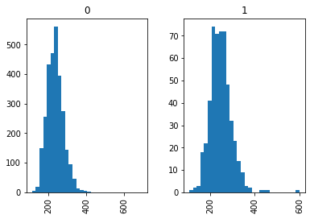
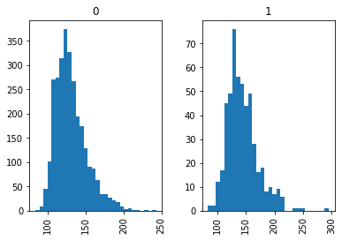
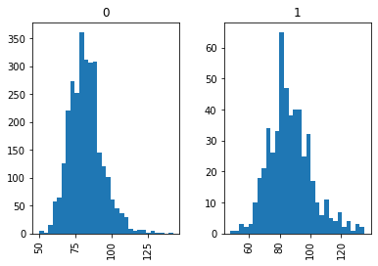
Distribution plots for different independent variables as per target variable labels
Ten Year CHD Values for different age values
Ten Year CHD Values for different totChol values
Ten Year CHD Values for different sysBP values
Ten Year CHD Values for different diaBP values

Slide 7
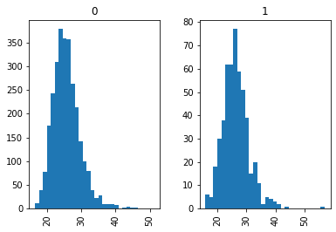
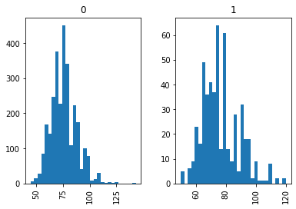
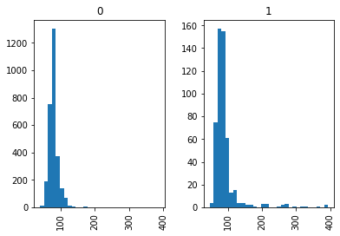
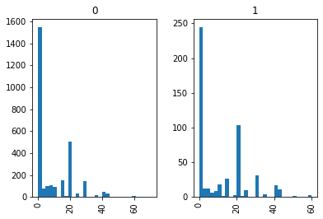
Distribution plots for different independent variables as per target variable labels
Ten Year CHD Values for different heart Rate values
Ten Year CHD Values for different BMI values
Ten Year CHD Values for different glucose values
Ten Year CHD Values for different cigsPerDay values

Slide 8
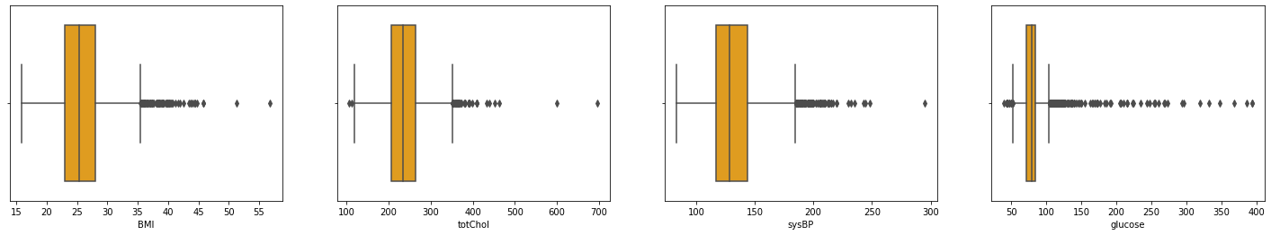
Outlier Detection using Box Plot

Slide 9
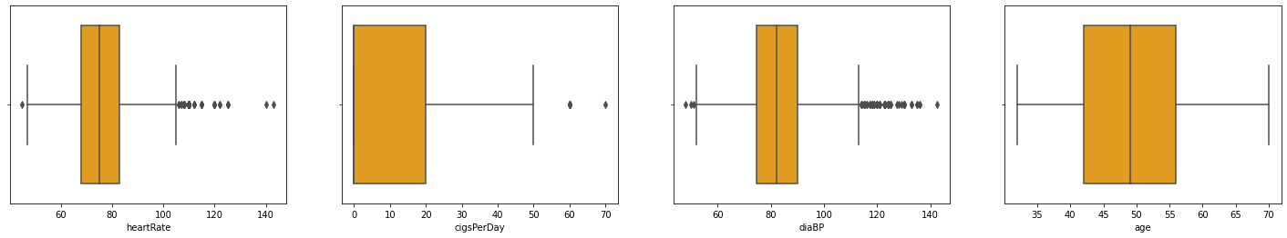
Outlier Detection using Box Plot

Slide 10
Data preparation
Initial Data Shape - 3390 Rows and 17 Columns (1 column is dependent)
After resampling dataset :
Training Data - 4606 Rows and 17 Columns ( 1 column dependent)
Test Data - 1152 Rows and 17 Columns (1 column dependent)
Dependent column will be predicted as that is the target variable named “Ten Year CHD.

Slide 11
Random Forest Classifier without resampling
Evaluation Metrics for test data
Accuracy score-> 0.8362831858407079
Precision score-> 0.1818181818181818
F1 Score-> 0.03478260869565218
Precision and F1 score are very less due to unbalanced dataset

Slide 12
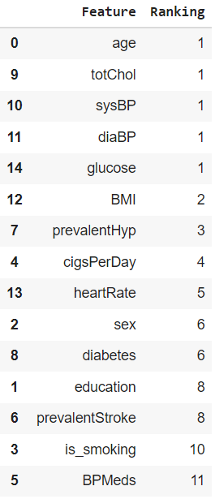
Significant features ranking using boruta selector

Slide 13
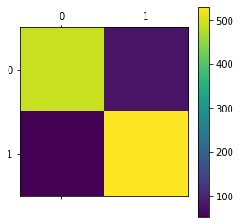
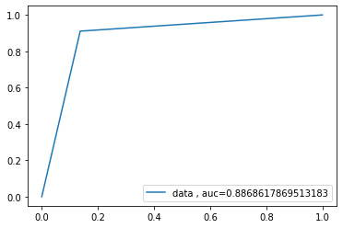

Random Forest Classifier after resampling
Evaluation Metrics for test data
Accuracy score-> 0.8871527777777778
Precision score-> 0.8719211822660099
F1 Score-> 0.8909395973154361
ROC Curve

Slide 14
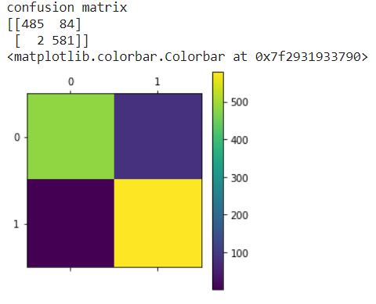
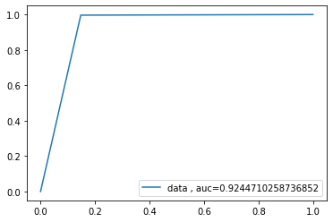
K Neighbour Classifier after resampling
Evaluation Metric for test data
Accuracy Score : 0.9253472222222222
Precision Score : 0.8736842105263158
F1 Score :0.9310897435897436
Confusion Matrix
ROC Curve

Slide 15
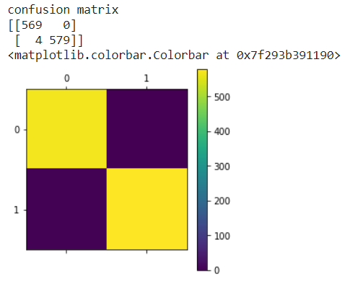
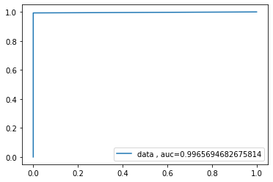
SVM Classifier after resampling
Evaluation Metric for test data
Accuracy Score : 0.9965277777777778
Precision Score : 1.0
F1 Score :0.9965576592082617
Confusion Matrix
ROC Curve

Slide 16
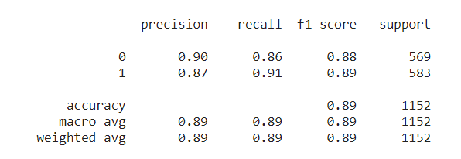
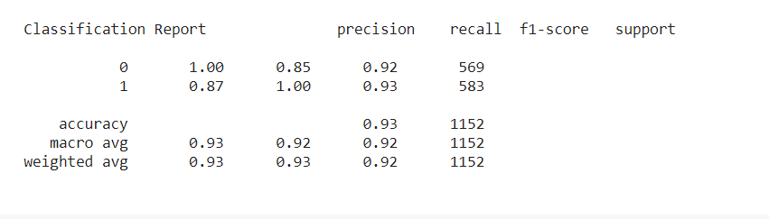
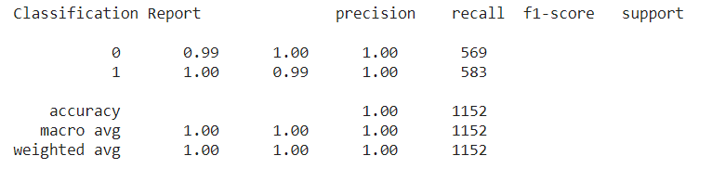
Classification Report for different Models
Random Forest Classifier
K Neighbour Classifier
SVM Classifier

Slide 17
Conclusion
All metrics were evaluated for each model like accuracy score, precision score, f1 score, roc curve and confusion matrix. Resampling of data was performed as the data was not balanced. Imbalance data can give high accuracy but precision and F1 score needs to be taken care of in such cases.
Support Vector Classifier predicting the target variable for testing data more correctly as per all evaluation metrics like roc-auc curve, precision, accuracy, f1 score. Other Models like K neighbour Classifier and Random Forest Classifier are working well too.
Since it is a medical diagnosis cases, we would want the false negative values to be less. In Svm classifier the False negative value comes out to be 4 as per confusion matrix. In K Neighbour Classifier, the False negative value is only 2. For random forest, false negative values comes out to be 52. So preferably, K Neighbour classifier and Support vector classifier seems to be more perfect for classification in this case.

Slide 18
THANK YOU

